Slide 1
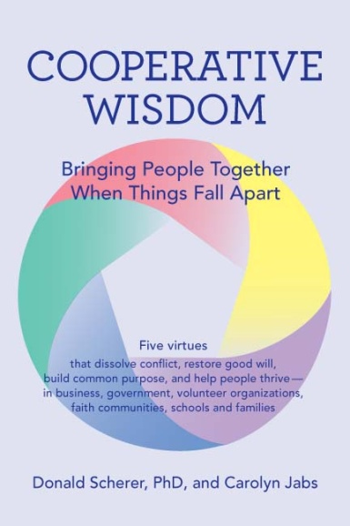
Cooperative Wisdom:
Bringing People Together When Things Fall Apart
Five Social Virtues that dissolving conflict, restore good will,
build common purpose, and help people thrive—
in business, government, volunteer organization,
faith communities, schools and families
By Dr. Donald Scherer and Carolyn Jabs, M.A.

Slide 2
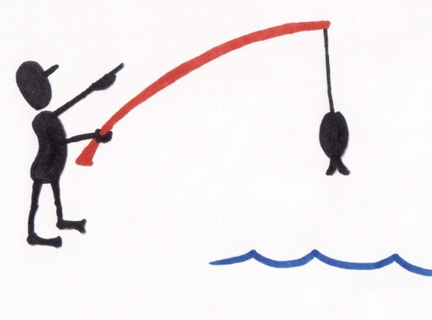
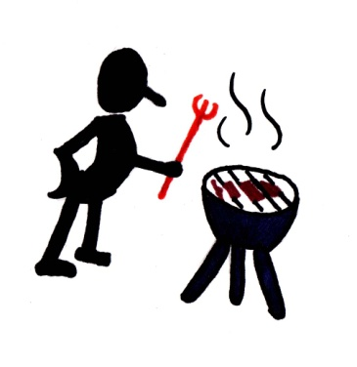
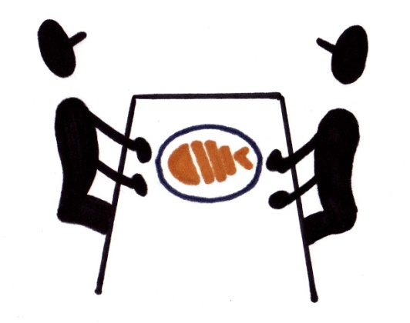
Cooperation is at the root of human flourishing.
I do this.
You do that .
Both of us are better off.

Slide 3

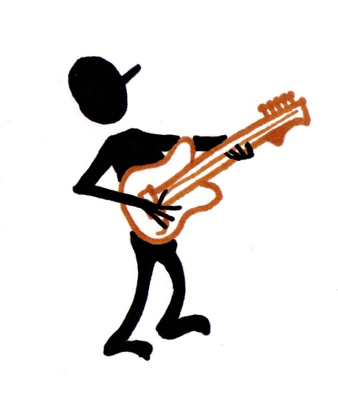
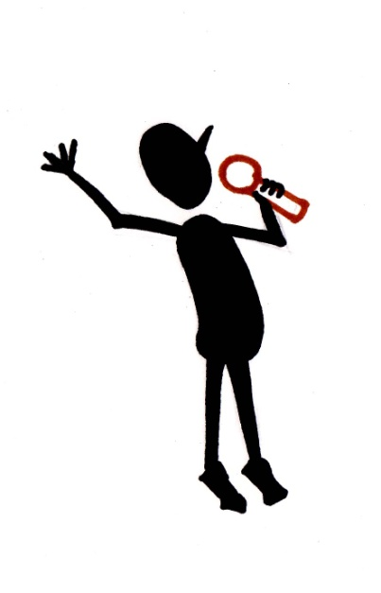

When cooperation works,
Individuals are happy
because they get to do
what they do well
AND they get the benefits of what others do.

Slide 4
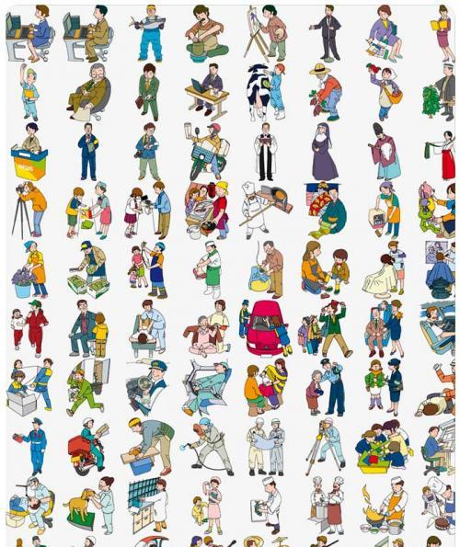
Millions of us participate in this cooperative bargain.
Most of the time,
it works very well.
We really are better off
when each of us does
his or her part.
So most people cooperate
most of the time.

Slide 5
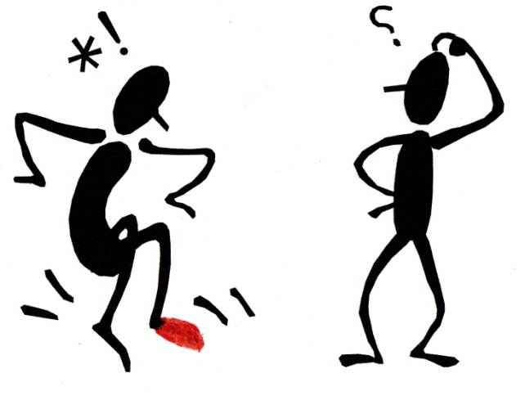


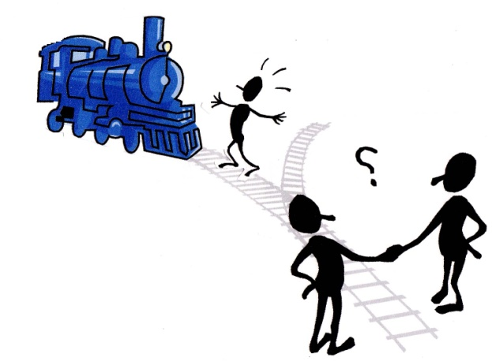
Three kinds of trouble … even though we tried to cooperate
Ouch – I got hurt!
Oops – You got hurt!
Oh no!! -- Someone
we don’t know got hurt

Slide 6
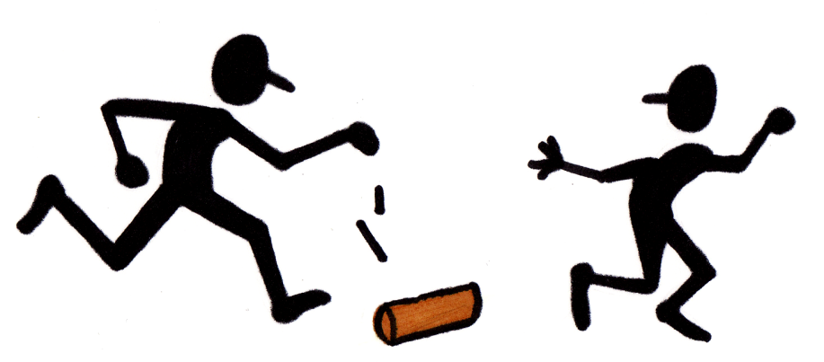
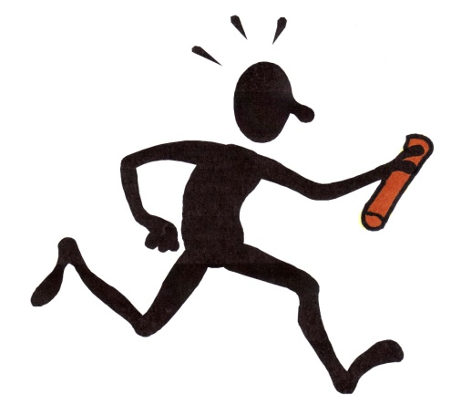

When cooperation doesn’t produce mutual benefits, people get upset!
Something bad happens….
“I did MY part,…
It must be YOUR fault!”

Slide 7

Often the other person feels the same way:
“I did MY part.
Things didn’t work out.
It must be YOUR fault.”
This is a recipe for conflict.

Slide 8
Three big reasons things don’t work out as expected
Loss of focus
Problems of scale
Variations in tolerance
.

Slide 9
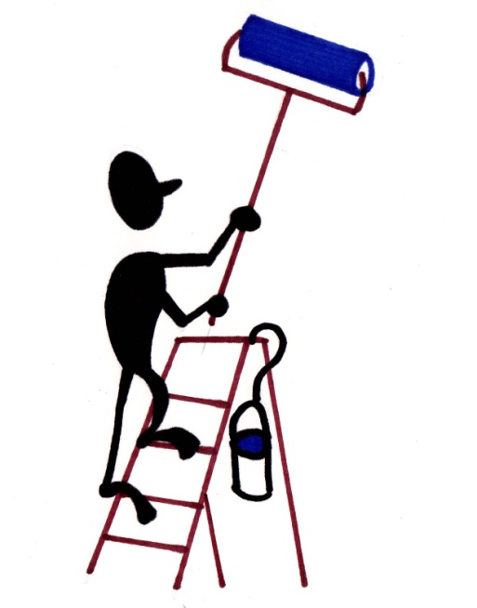
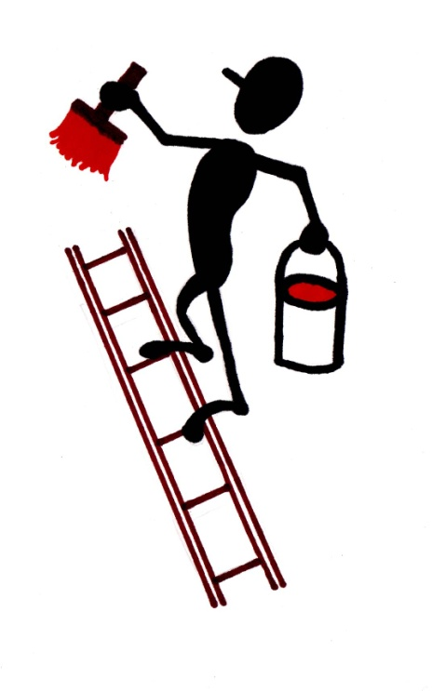
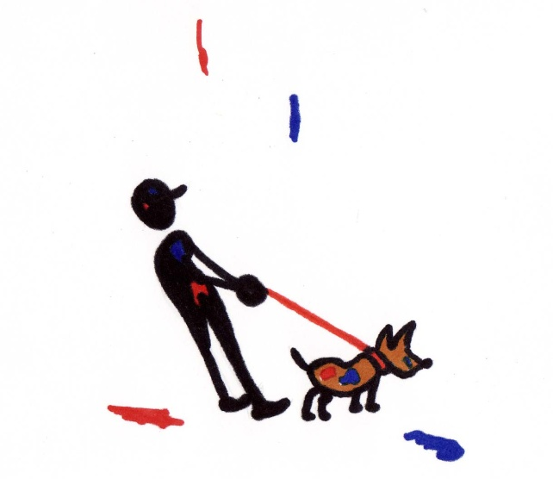
Loss of focus:
Things fall through the cracks!
I do this You do that
Nobody notices
what’s happening here!

Slide 10
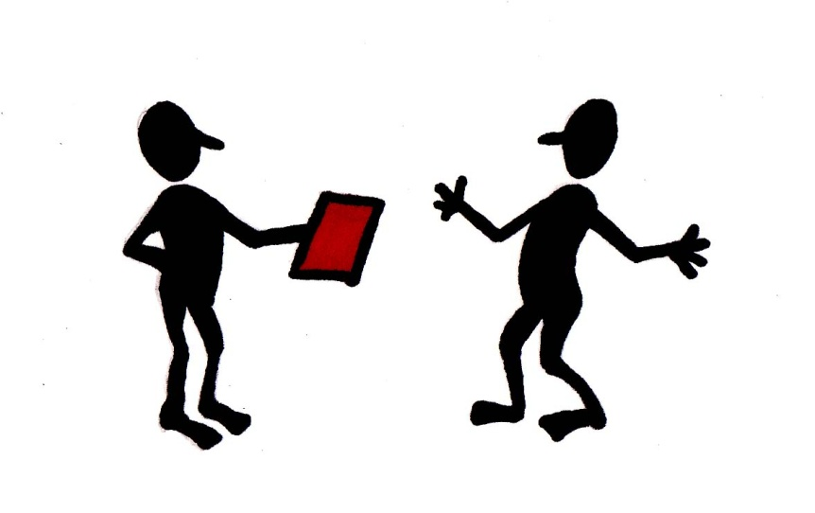

Problems of Scale:
What if everybody did that?
Something that is harmless
when some people do it
Becomes a problem
when too many people do it.

Slide 11
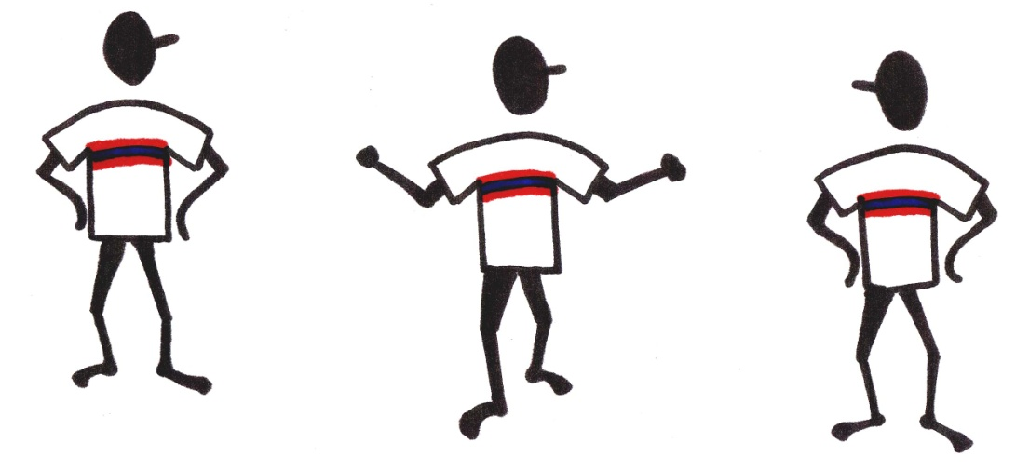

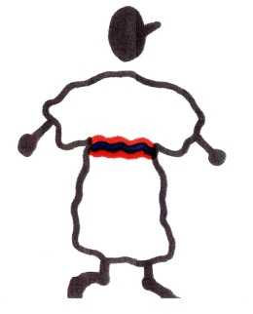
Variations in Tolerance:
One size does NOT fit all
What we tried to do
worked really well for some…
And caused serious
problems for others!

Slide 12
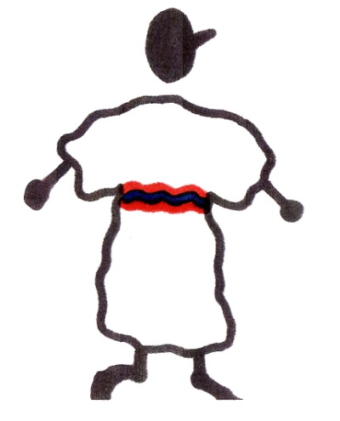
In these situations, people get upset.
Everyone sincerely tried to do the right thing,
but there were unintended consequences.
Things went wrong, sometimes terribly wrong.

Slide 13
Traditional morality says:
“Someone messed up.”
Find that person.
Punish them.
Things will be OK again.

Slide 14
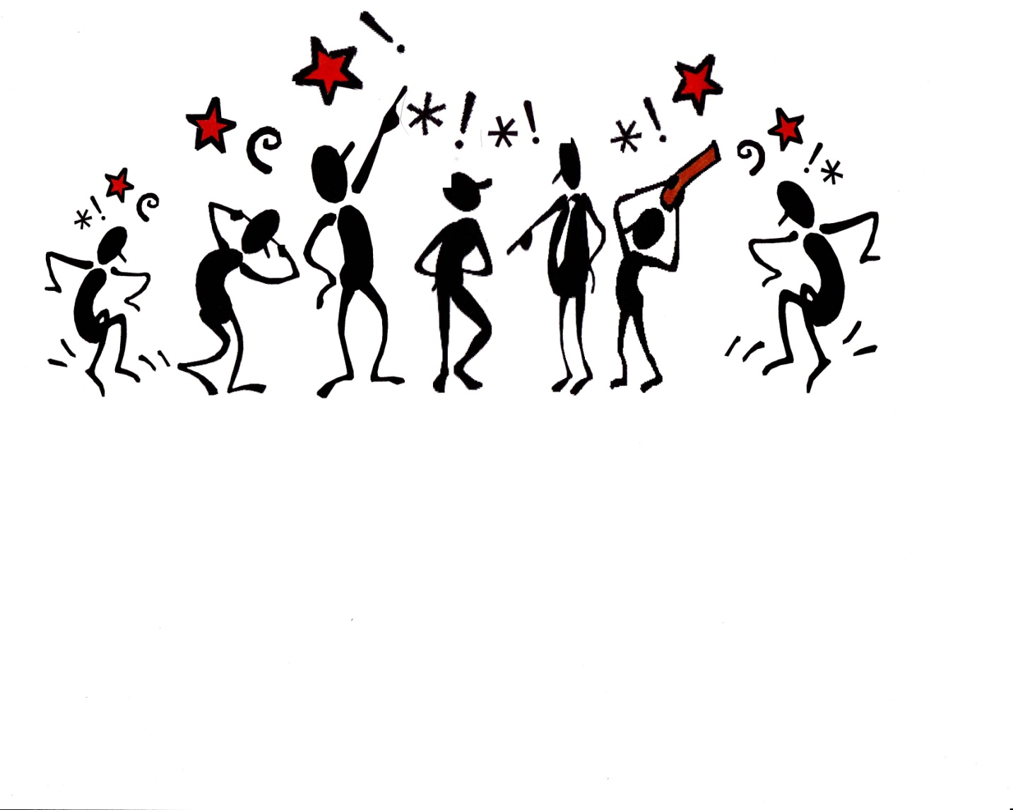
That approach fails when ‘who’s wrong’ is not the issue.
If everyone tried
to do the right thing,
blame simply
stirs conflict!
We need a new approach!

Slide 15
A Better Analysis:
The environment has changed
Physically
Socially
Institutionally
What may have worked very well in former environments simply doesn’t work in the new environment.
Notes:
When things go wrong,
despite good intentions,
people feel stuck,
frustrated and angry.

Slide 16
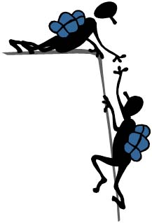
A Better Question:
How can we
restore cooperation
in a changed
environment?

Slide 17
The Five Social Virtues Promise to
Dissolve conflict
Nobody intended to cause harm.
We all did our best so blame isn’t helpful.
Restore cooperation
Reorganize whenever harm becomes apparent.
Make sure benefits are truly mutual.

Slide 18
What are the Five Social Virtues?
Proactive Compassion – anticipate and respond to vulnerabilities
Deep Discernment -- discover bedrock values
Intentional Imagination – expand what’s possible
Inclusive Integrity -- rework cooperation so everyone thrives
Creative Courage -- embrace the risks of engagement)

Slide 19
Benefits
For the Individual –
A richer understanding of
what it means to be good.
(It’s not all about you!)
For the Community –
Improved cooperation.
(It is all about us!)

Slide 20
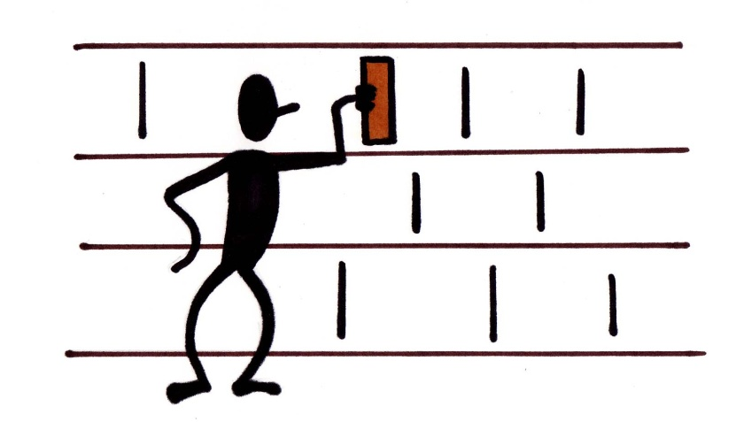

How this works
A public library has a
deteriorating collection.
Taxpayers are reluctant to increase funding.
Like so many conflicts, this is fundamentally
an argument about how to allocate resources
in a changing environment.

Slide 21
How should we start?
Step 1 – Compassion
Where is the vulnerability?
Without a good library, some people will be cut off
from information and opportunities to learn.
Step 2 – Discernment
What values are at stake?
Librarians feel passionately about their mission
Patrons want access to books and other learning materials.
Taxpayers feel beleaguered by competing demands.

Slide 22
Step 3 – Imagination -
Re-conceive what’s possible
Most people think of imagination as a gift.
You have it or you don’t.
Imagination is actually a decision.
Anyone can learn practices that
improve their capacity for imagination
on behalf of the community.

Slide 23
Three Practices of Imagination
Conserve known resources
Look for untapped resources
Rethink waste
Mastering these practices allows us to
generate promising solutions to
to problems that look “insoluble.”

Slide 24
Conserve known resources
Teach patrons, especially children, to be
careful with books so they last longer.
Impose larger fines so books are more likely
to be returned.
Restrict some materials to library-only use.
Look for vendors that give deeper discounts.

Slide 25
Look for untapped resources
Encourage families to donate books their
children no longer use.
Seek grants for purchasing books.
Supplement the collection with virtual books
patrons can read on electronic devices
Charge for library cards.

Slide 26
Rethink waste
Recruit volunteers to repair books that might
otherwise be discarded.
Salvage illustrations from damaged books,
frame and sell them.
Study usage patterns in the library and assign staff to
other duties when patrons are scarce.

Slide 27
Two more steps
Step 4 – Integrity
How can we coordinate our efforts?
Step 5 – Courage
What risks does cooperation require?
Each step has its own practices
(described in detail in the book.)
Notes:
Librarians must integrate what matters to them
with what matters to key cooperative
partners including patrons, staff, volunteers,
community groups and local government.
A sustainable solution to the library’s problems
involves risk and necessitates trust.

Slide 28
Learning new habits of cooperation
requires hard work and
real commitment to each other.
Why bother?

Slide 29
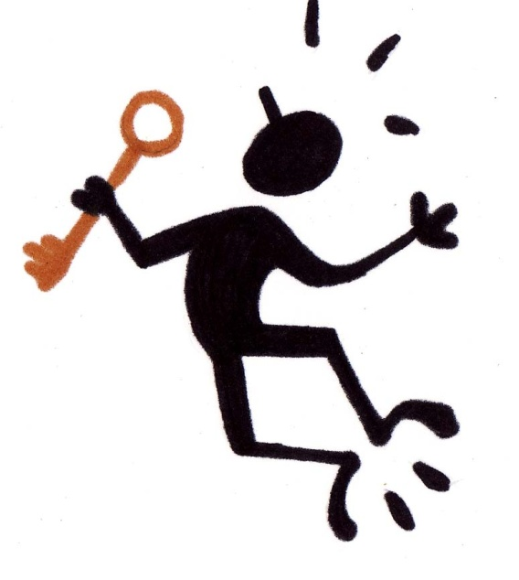
The Promise of the Social Virtues
An alternative to cynicism,
apathy and despair,
A way to respond to conflict
that leads to fewer dead ends
and more opportunities.

Slide 30
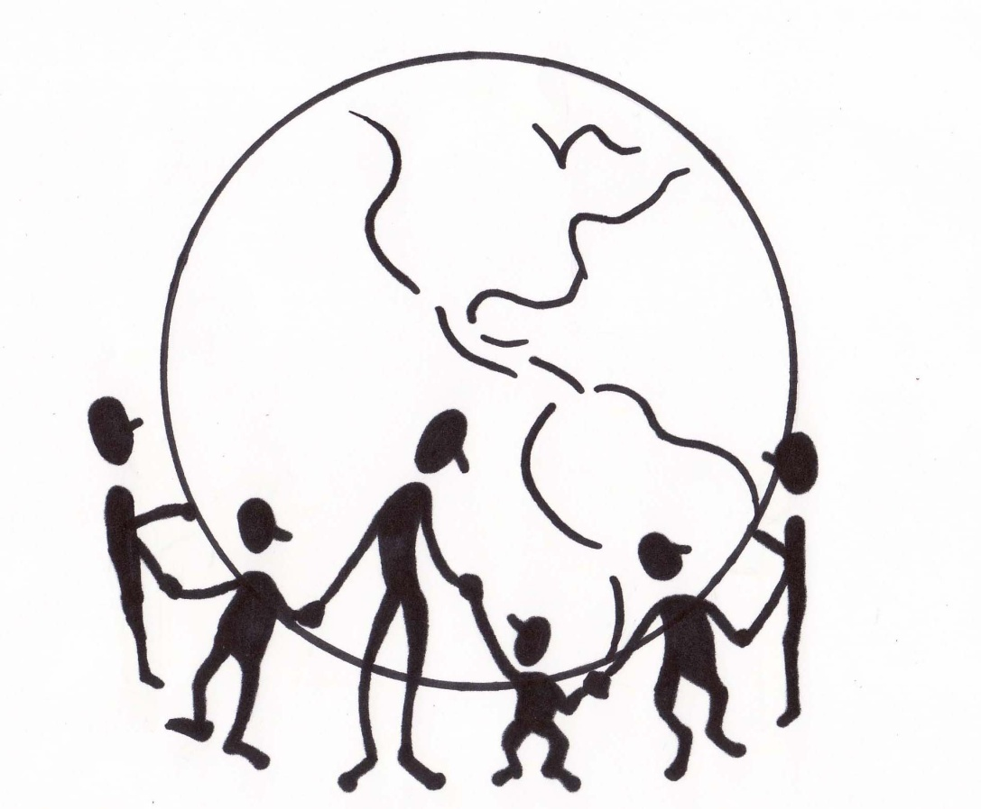
The Five Social Virtues lead to Cooperative Wisdom
Dissolve conflict.
Restore cooperation.
So we can flourish
together!

Slide 31
Cooperative Wisdom:
Bringing People Together when Things Fall Apart
By Dr. Donald Scherer and Carolyn Jabs, M.A.

Slide 32

Published by
Green Wave Books
Spring, 2016
Distributed by
Amazon and Ingram
Please visit
CooperativeWisdom.org
And like us on Facebook/
CooperativeWisdom

